Slide 1
Resource Presentation:
tidycensus
Course: GEO 511
Semester: Fall 2022
Instructor: Adam M. Wilson
Presenter: Suiyuan Wang

Slide 2

Author: Kyle Walker. Author, maintainer
Associate Professor of Geography and Director of the Center for Urban Studies at Texas Christian University.
Author of the book Analyzing US Census Data: Methods, Maps, and Models in R.
R developer:
  tidycensus, which helps R users get demographic & spatial data from the US Census Bureau ready-to-go for use in their analyses;
  tigris
Researching data science and visualization tools for spatial demography.
Personal firm, Walker Data.

Slide 3
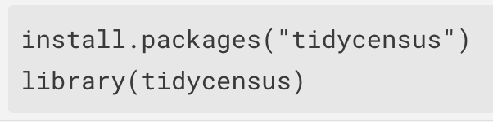
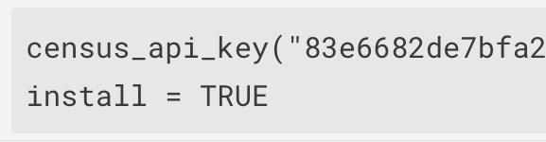
Package
tidycensus is an R package that allows users to
interface with a select number of the US Census Bureau’s data APIs
return tidyverse-ready data frames,
optionally with simple feature geometry included.
Install from CRAN:
Set Census API key. A key can be obtained from http://api.census.gov/data/key_signup.html.

Slide 4
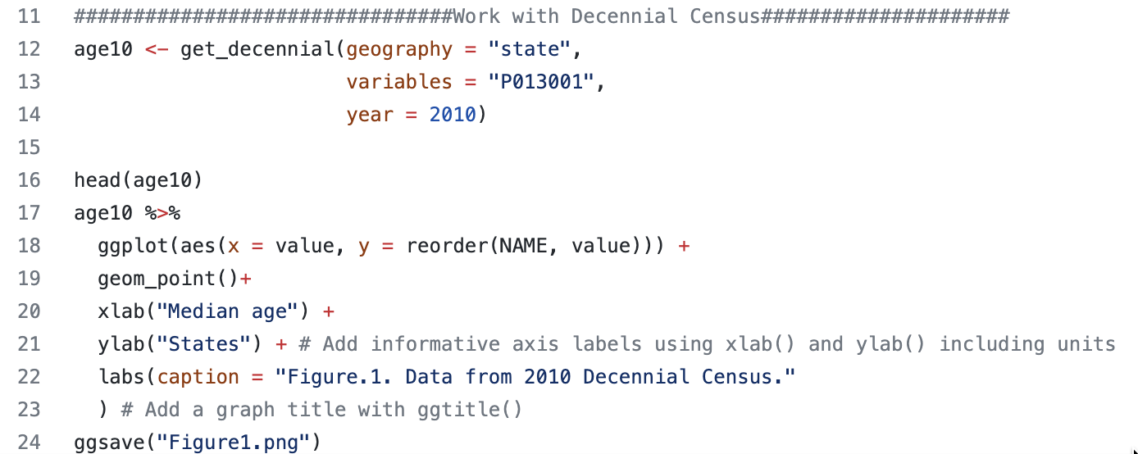
Example1: Decennial Census

Slide 5
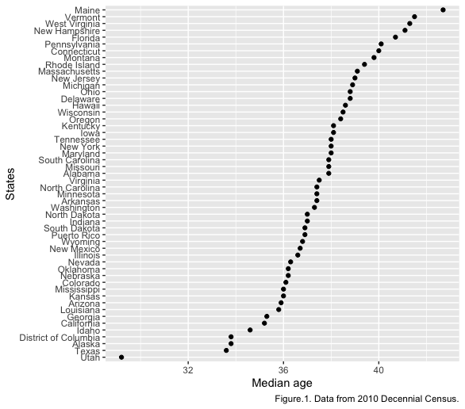
Plot for example1

Slide 6
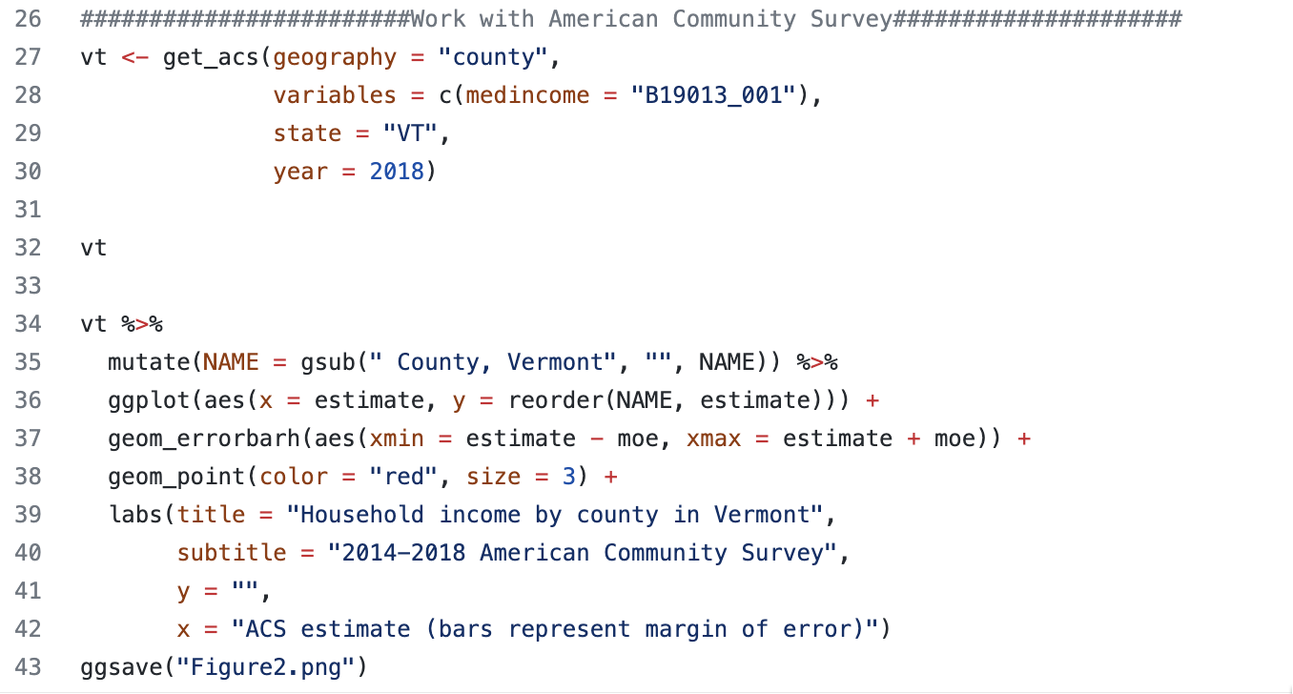
Example2: American Community Survey

Slide 7
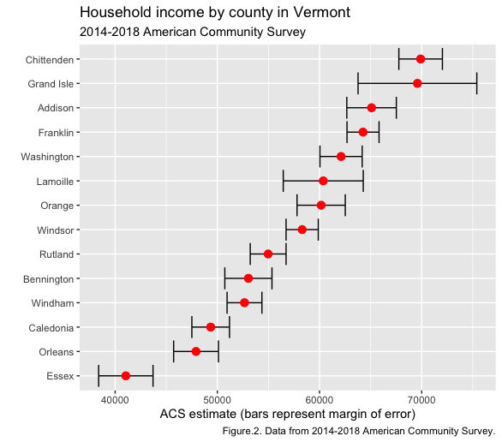
Plot for example2

Slide 8
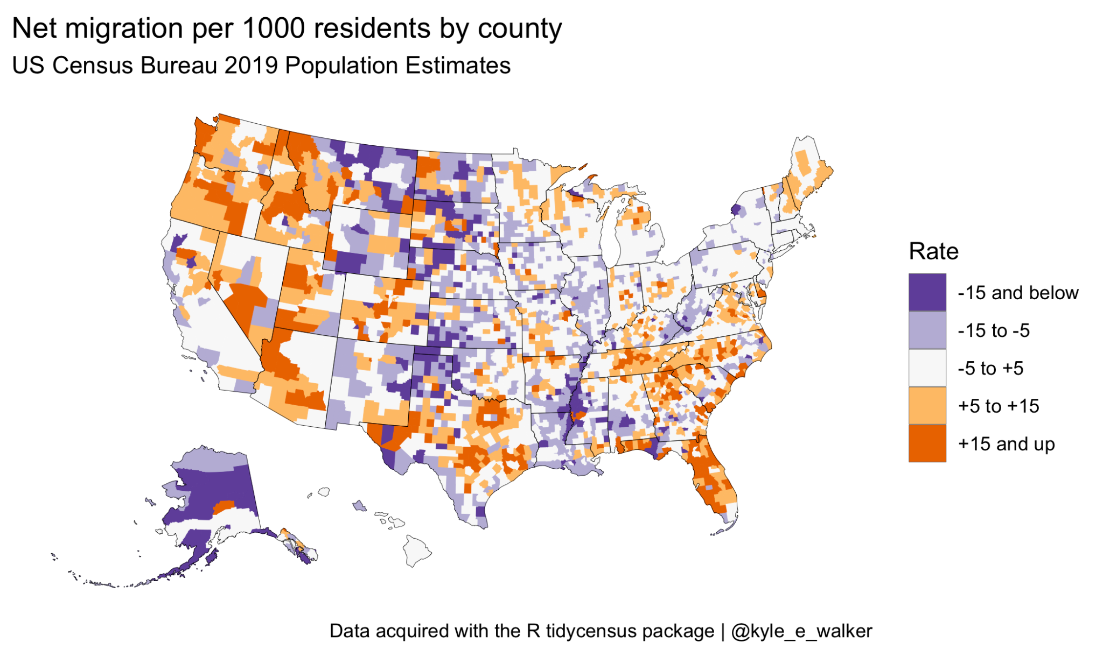
Example3: Population estimation Project

Slide 9
Reference
1. https://cloud.r-project.org/web/packages/tidycensus/index.html
2. https://walker-data.com/tidycensus/index.html
3. Getting Started with American Community Survey Data in R and Python
https://www.youtube.com/watch?v=h1BWuz0mdcs

